Slide 1





AgriAI-An AI assisted IoT platform
Team Name: Databaes
Domain: IoT and Smart Devices

Slide 2


Problem Statement
What problem are you looking to solve?
We are looking to solve the lack of technology-driven decision support in Indian farming, where limited use of real-time data and predictive analytics leads to suboptimal yields. This gap results in inefficient resource use, reduced productivity, and significant financial losses from failed or underperforming harvests.

Slide 3

Product Idea
How does your Product solve the problem?
We aim to develop an AI assisted IOT based platform to predict crop yields using historical and real time agricultural data, weather patterns, and soil health metrics. The system providesactionable recommendations for farmers to optimize irrigation, fertilization, and pest control, tailored to specific crops and regional conditions.

Slide 4

Additional Info
We are developing a crop yield prediction system, which combines different machine-learning models into a hybrid stack, consisting of XGBoost, ARIMAX-LSTM sequence modelling, and ridge regression to obtain sound and bias-free predictions. The farmers enter their district/location, crop, plot size, and date sown which is then matched with historical weather data (30+ years) for that district (temperature, rainfall, soil moisture), crop yield data, and a 10-year daily NASA-POWER weather layer of precipitation, air temperature at 2 m, shortwave radiation, and humidity. XGBoost is used to obtain the patterns of yields at the district level, whereas ARIMAX-LSTM obtains the most recent exogenous variables such as rolling NDVI of Oceansat-2/Bhuvan Store, local weather and irrigation to get dynamic yield outputs, all synced to crop seasons to prevent look-ahead bias.
We map NPK mixes of fertilizers to each crop algorithmically, and we schedule irrigation with FAO-56 evapotranspiration equations (pyfao56) adjusted with a Random-Forest residual model that has been trained on local historical versus forecast ETo and crop-specific Kc curves. Lastly, the system produces spot-specific yield estimates and 7-day practical irrigation plans.

Slide 5
How Unique is it?
Existing Work vs Coined Novelty
Existing Work:
Current solutions in India offer satellite-based farm analytics, advisory apps, input marketplaces, and remote sensing yield indicators. However, these are mostly stand-alone services with limited real-time field sensing and execution support.
Coined Novelty:
Very few solutions tightly integrate field-level NPK
microclimate + hybrid bias-aware ML models + operational FAO-56 irrigation recommendations + low-bandwidth connectivity, and farmer-friendly interfaces (voice + marketplace escrow), creating an end-to-end actionable system tailored for smallholder conditions.

Slide 6
Tech Stack
Framework?
Database?
APIs?
ML?
Sky is the Limit?

Slide 7
IOT Tech Stack
Edge / Field Layer
ESP32 microcontroller
ZTS-3002 soil sensor (Moisture, Temperature, pH, NPK)
DHT11 air temperature & humidity sensor
RTC module for timestamping
Li-Po battery with deep sleep power optimization
Edge preprocessing: validation, filtering, normalization
Connectivity Layer
LoRa (RYLR998) for long-range rural communication
LoRa Gateway (Wi-Fi / 4G backhaul)
MQTT / HTTPS data transmission
TLS-based secure communication
Cloud & Data Layer
Cloud Platform: AWS / Azure / GCP
Time-Series Database: InfluxDB
Relational Database: PostgreSQL
External Data: NASA POWER, OpenWeather API, Bhuvan NDVI
ETL & Feature Engineering: Python (Pandas, NumPy)

Slide 8





Software Tech Stack
MACHINE LEARNING
Render
XGBoost
RandomForest
ARIMAX-LSTM hybrid models
PyFAO-56 libraries
Jupyter Notebook
BACKEND
REST API
Flask
Cryptography
Supabase
FastAPI
PostgreSQL
WEBDEV
React
Tailwind
Framer motion
Vite
AI CHATBOT
WebRTC
AI4Bharat Indic-Automatic Speech Recognition (ASR)
AI4Bharat Indic-Text-to-Speech (TTS)
AI4Bharat Indic-Bert (LLM)
WebAudio API
Twilio

Slide 9


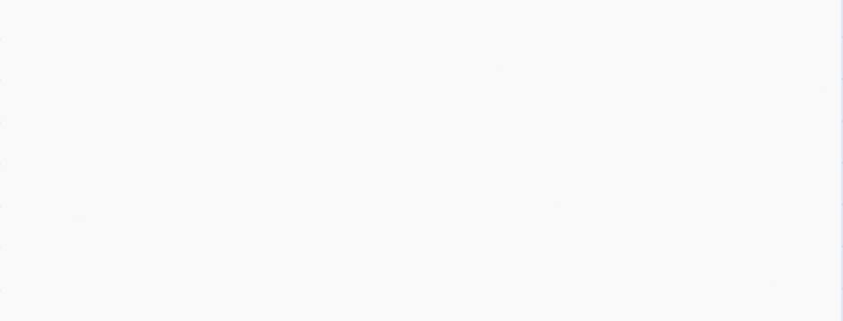
Team Members
Team Lead: Ritvik Bhat
Email: ritvikarunbhat@gmail.com Phone: 9930435569
Member 1: Keerti Krishna Likhita
Email: keerti.likhita2@gmail.com
Phone: 7249755897
Member 2: Aditya Kumar Sharma
Email: shradi0612@gmail.com
Phone: 9981521140
Member 3: Shivansh Sood
Email: sood.shivansh13@gmail.com
Phone: 8595788540

